Slide 1

Assistance Chatbot for Android Developers
SJSU CMPE 295B
Fall 2018
By: Abhishek Upadhayay
Manasi Joshi
Neil Thaker
Purvesh Kothari
Project Advisor: Prof. Charles Zhang

Slide 2
Introduction
Android is the most popular OS for smartphones and its ever increasing usage
Traditional developer forums and search engines requires the search queries very specific or returns a list of results that developers find it difficult to go through
No support for the contextual conversations as well
This chatbot aims to solve these problems

Slide 3
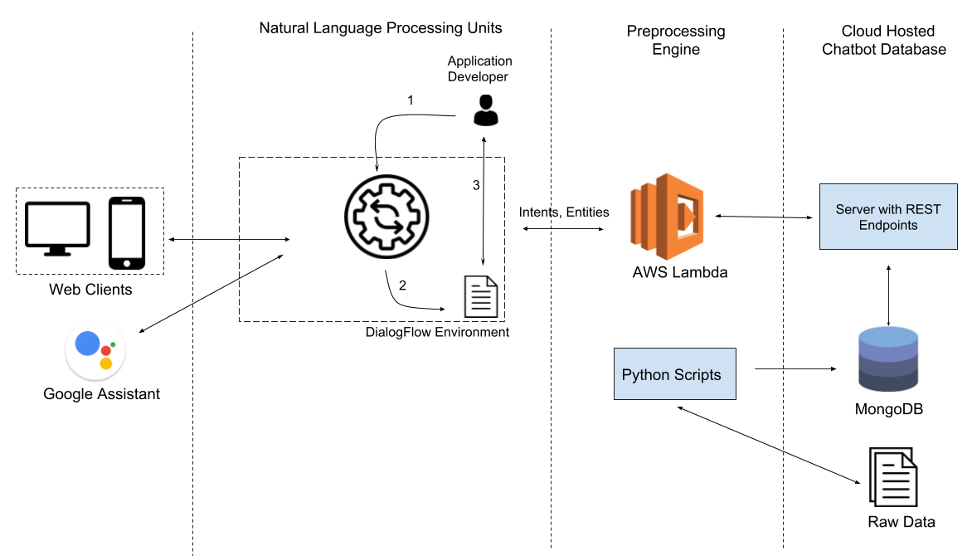
System Architecture

Slide 4
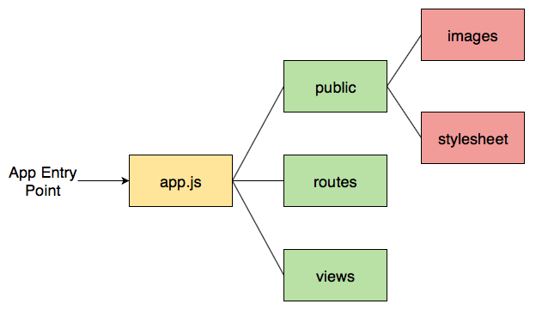
Frontend Clients
Web based client supported by major browsers developed using NodeJS, Express and bootstrap template
Takes input in text and voice
Provides response in rich media including hyperlinks and images
Real-time speech to text support

Slide 5
DialogFlow
Natural Language Processing and Understanding platform provided by Google as a service
Supports wide variety of configurations
Enables to develop contextual conversation
Involves a lot of work to train the models by determining the training phrases, intent, and entities

Slide 6
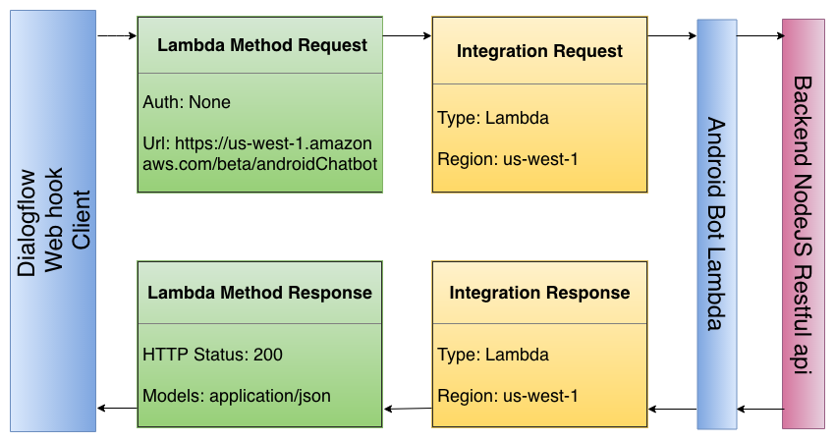
AWS Lambda
Secure and provides connection over HTTPS for DialogFlow fulfilment
Supports wide variety of programming languages
Logging using CloudWatch

Slide 7
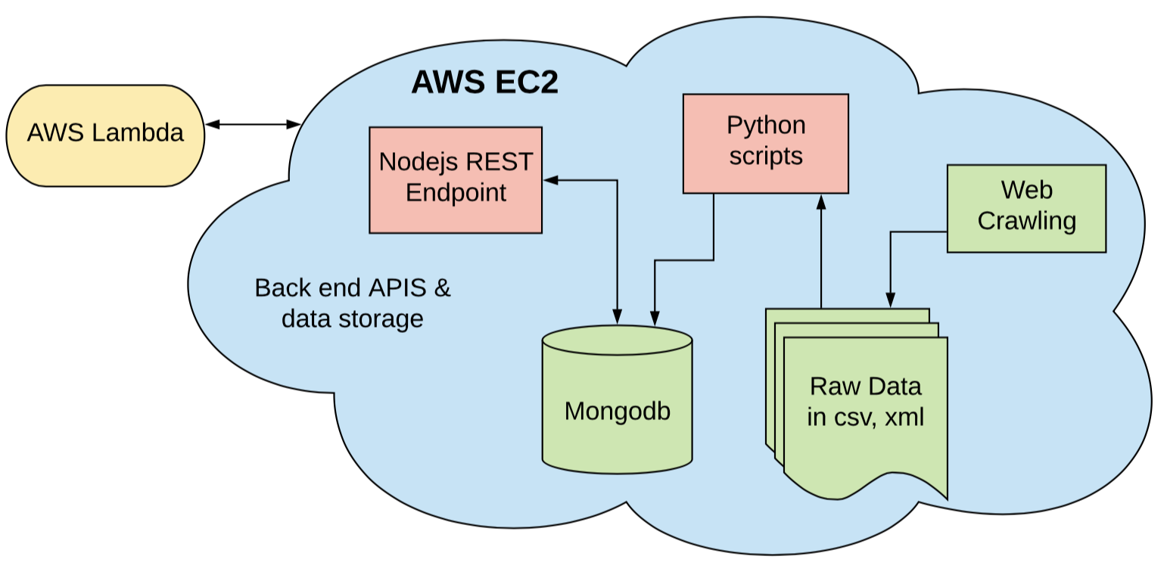
Backend API
REST APIs developed in NodeJS
Raw data gathered using web crawlers
Data processing done using Python scripts
Data stored in MongoDB
Experimental usage of TensorFlow and TFLearn

Slide 8
Demo

Slide 9
Thank You

